Slide 1
MNR GROUP
100% Export Oriented Flat Knitting manufacturer Industries
www.mnrgroupbd.com

Slide 2
MNR GROUP
100% Export Oriented Flat Knitting manufacturer Industries
www.mnrgroupbd.com

Slide 3
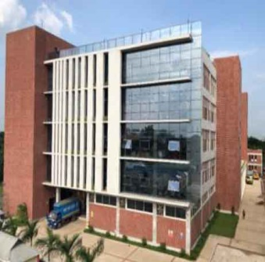
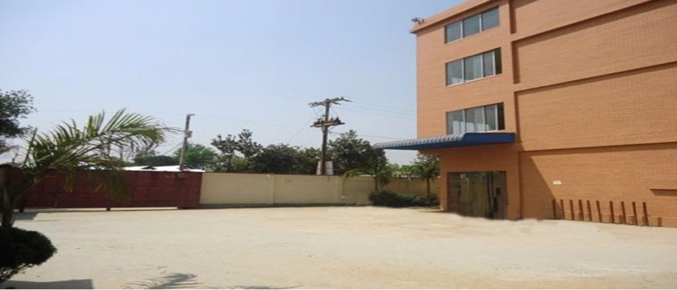
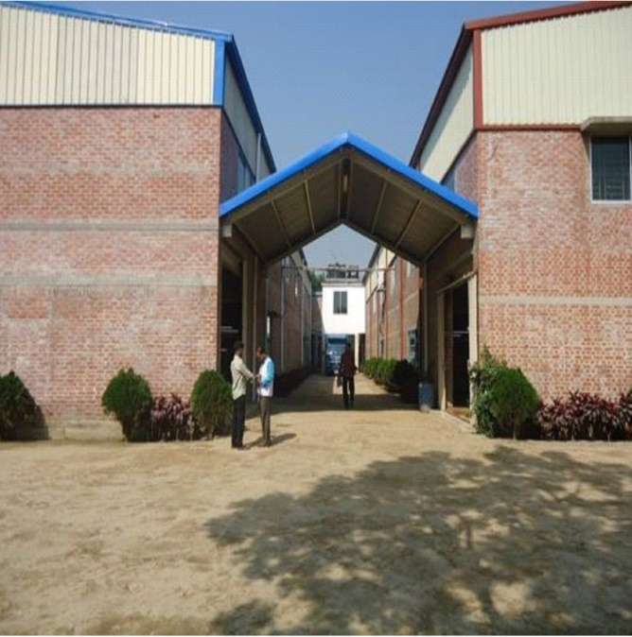
BUSINESS UNITS
MNR GROUP
100% Export Oriented Flat Knitting manufacturer Industries
www.mnrgroupbd.com

Slide 4
EQUIPMENTS & CAPACITY
Jacquard Machines : 1100
Shima Seiki (Japan) = 720
3 / 5 / 7 gauge machines 280
12 /14 gauge machines 440
Cixing/Steiger (China) = 380
12/14 gauge machines 270
5/7 gauge machines 110
Total Capacity
Yearly= 1,20,00,000 pcs Monthly = 10,00,000 pcs (million)
MNR GROUP
100% Export Oriented Flat Knitting manufacturer Industries
www.mnrgroupbd.com

Slide 5
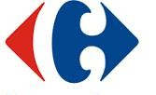
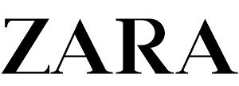
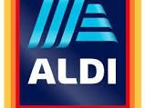
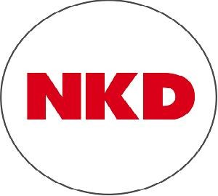
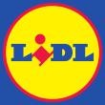
OUR PARTNERS
MNR GROUP
100% Export Oriented Flat Knitting manufacturer Industries
www.mnrgroupbd.com

Slide 6
CUSTOMER MAX
MNR GROUP
100% Export Oriented Flat Knitting manufacturer Industries
www.mnrgroupbd.com

Slide 7
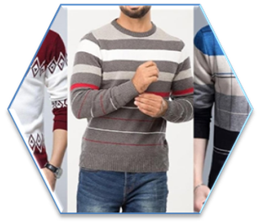
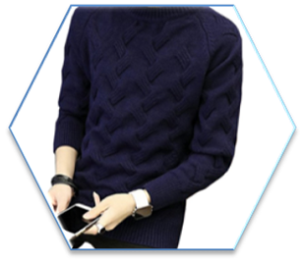
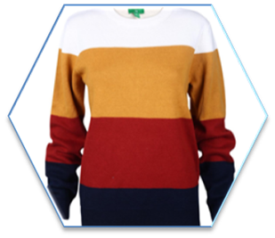
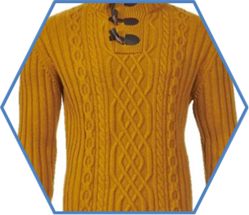
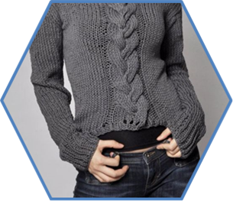
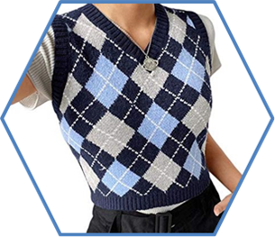
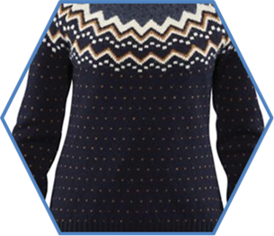
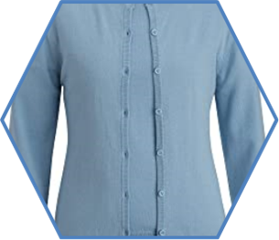
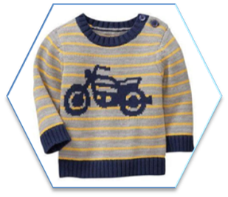
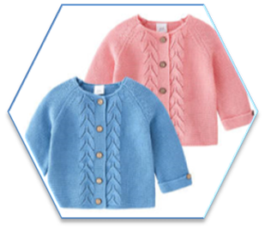
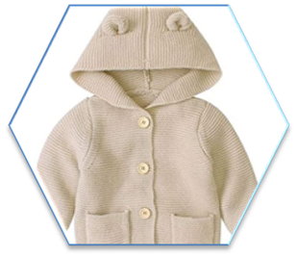
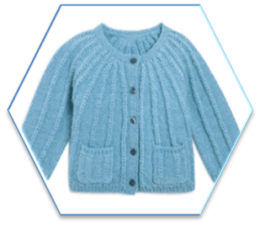
OUR PRODUCT
MENS
WOMENS
KIDS
MNR GROUP
100% Export Oriented Flat Knitting manufacturer Industries
www.mnrgroupbd.com

Slide 8
Production Floor
Knitting Section
Linking Section
Winding Section
Washing Section
Finishing Section
Packing Section
MNR GROUP
100% Export Oriented Flat Knitting manufacturer Industries
www.mnrgroupbd.com

Slide 9
Storing and Finished Goods
MNR GROUP
100% Export Oriented Flat Knitting manufacturer Industries
www.mnrgroupbd.com

Slide 10
Design Studio
MNR GROUP
100% Export Oriented Flat Knitting manufacturer Industries
www.mnrgroupbd.com

Slide 11
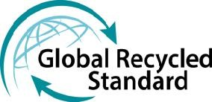
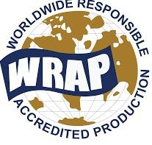
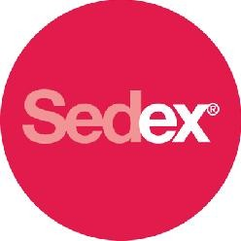
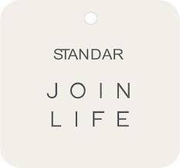
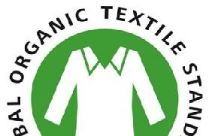
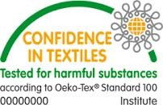
CERTIFICATIONS
MNR GROUP
100% Export Oriented Flat Knitting manufacturer Industries
www.mnrgroupbd.com

Slide 12
SUSTAINABILITY
The job of protecting the environment from harmful by products of operations has encouraged our sustainability team to start a number of initiatives that not only save resources for the country but also cost effective where the main focus is to incorporate the 3’R’s.
Go
Green
Reduce
Recycle
Reuse
As a part of our environmental goals, MNR Design Ltd. has recently achieved the highest distinction in LEED Certification by the US Green Building Council (USGBC).LEED Rating System is the foremost program for buildings, homes and communities that are designed, constructed, maintained and operated for improved environmental and human health performance.

Slide 13
CONTACT US
Bank Details:
Mercantile Bank Ltd.
Gulshan Branch,
106 Gulshan Avenue.
Dhaka 1212, Bangladesh.
Phone # +8802-8835276
Fax # +8802-8835614. SWIFT: MBLBBDDH019
Corporate Office :
House : 488 (1st & 2nd Floor), Road : 8, DOHS Baridhara, Dhaka-1206, Bangladesh.
Phone : +8802-8415623-24,
Email : info@mnrgroupbd.com Web : www.mnrgroupbd.com
Factory Address:
Baraiderchala, Sreepur,
Gazipur – 1740, Bangladesh.
MNR GROUP
100% Export Oriented Flat Knitting manufacturer Industries
www.mnrgroupbd.com

Slide 14
THANK YOU
www.mnrgroupbd.com
MNR GROUP
100% Export Oriented Flat Knitting manufacturer Industries
www.mnrgroupbd.com

